Slide 1
Gathering Credible Data
Seattle Indian Health Board
Urban Indian Health Institute
Shayla R. Compton, MPH
University of Washington School of Public Health
Notes:
Thank you for joining us for “Gathering Credible Data.” My name is Shayla Compton and I will be leading today’s session. I’m a graduate from the University of Washington’s School of Public Health with a concentration in Community-Oriented Public Health Practice. I have spent the greater part of the last year volunteering with the Urban Indian Health Institute, and I’m happy to have you here with us!
This webinar will be recorded and archived on the UIHI project website for future viewing.

Slide 2
Objectives of Session
Describe how data collection fits into program evaluation
Discuss general principles of data collection
Discuss considerations for selecting the right data collection methods for you
Overview of qualitative and quantitative data collection methods
Notes:
The objectives of this session are to:
Describe how data collection fits into program evaluation,
Discuss general principles of data collection
Discuss considerations for selecting the right data collection methods for you, and
Overview of qualitative and quantitative data collection methods
I will present for about half an hour and then we will open the line up for questions and comments at the end of the webinar, so please write your questions down as we go along, or submit them using the chat feature. When you close out of this webinar an evaluation survey will appear on your screen. I would greatly appreciate if everyone would complete that survey as it is important for helping to improve future webinars.

Slide 3
Evaluation
Evaluation
Program Improvement
Accountability
Fundraising
Decision Making
Public Relations
Requirements
A systematic way of collecting information about the characteristics, activities, products, and outcomes of a program.
Patton, M.Q. (2008) Utilization-focused evaluation (4th edition). Thousand Oaks, CA: Sage.
Notes:
Before we discuss data collection methods, it will be helpful for us to have a common definition of evaluation and understand how data collection fits into program evaluation.
Evaluation is a systematic way of collecting information about the characteristics, activities, products, and outcomes of a program to:
Make judgments
Make improvements
Inform decisions and
Improve understanding
Evaluation can answer these seemingly basic questions: What are we doing or what happened? What difference did it make or what did we accomplish? And now what are we going to do?
There are many uses of evaluation, such as: Program improvement; improved accountability; grant writing/fundraising; informing policy and resource allocation decisions, planning and public relations; describing the program and its impact, or meeting program reporting requirements.

Slide 4
Evaluation Framework
Engage stakeholders
Ensure use and share lessons learned
Describe the program
Justify conclusions
Focus the evaluation design
Gather credible evidence
http://www.cdc.gov/eval/framework/index.htm
Notes:
This slide shows the Centers for Disease Control and Preventions framework for planning and conducting evaluations. Step 1 is to Engage Stakeholders
Step 2 is to Describe the Program
Step 3 is to Focus the evaluation design
Step 4 is to Gather credible evidence
Step 5 is to Justify conclusions
Step 6 is to Ensure use and share lessons learned
All of these steps are necessary for a useful evaluation; each step is part of an on-going learning cycle. Today we will focus on step 4: Gathering Credible Evidence, by discussing the different types of data collection methods and providing a few examples of how to use select methods to effectively answer evaluation questions.
By step 4 we have already defined the different aspects of our program and have an understanding of what each element is intended to achieve based on the logic model we have developed to describe our program. We have also identified the type of evaluation we want to conduct and have developed questions to help us understand if the program is working, why or why not it is working and measure specific indicators that are appropriate and relevant. Data collection is the stage in the evaluation process were we gather the information necessary to answer our evaluation question.

Slide 5
Data Collection Principles
Respect for clients
Clear and honest communication
Ensure the evaluation is culturally responsive
Address all questions or concerns
Share the data with participants and stakeholders
Notes:
Let’s begin by discussing some guiding principles to follow throughout the data collection process.
First, it is important when we assess various aspects of a program to place them within the context of relationships, community, and culture. When we conduct a program evaluation within this context we place respect for clients as a priority.
There are many ways we can show respect for clients throughout the evaluation process. Simple approaches that demonstrate respect for clients is by clearly and honestly communicating why data is being collected, how the data will be used, and who will have access to this data. Be transparent about the purpose of the evaluation
Ensure the evaluation being conducted is culturally responsive by acknowledging the importance of attending to the influence of race, gender, class, and other factors that might be dismissed though they are central elements of individuals’ lived experiences and realities.
You’ll also want to address questions about participating in evaluation efforts, and inform people of any possible disruption regarding access to services and continued participation in programming. Inform clients of how you plan to protect their privacy and when possible ensure confidentiality.
Lastly, inform all participants and stakeholders who has ownership of the data collected during the evaluation and how findings will be reported back to the community.

Slide 6
Data Collection Considerations
What information is needed?
Where is the information?
How much time is needed/available?
What resources are available?
Taylor-Powell, E. Planning a Program Evaluation (1996)
Notes:
So what do you need to consider to decide which data collection method will work best for your program evaluation? There are many things to think about, but here are four questions we should ask ourselves before moving forward with a decision.
What is the information that you need? What type of data will best answer your evaluation questions? Are there specific measures that you are required to report for funding purposes? Consider what information is needed that is different than what is already available.
Where is the information? The most common sources of evaluation information are existing documents, people, and observation. Once you have identified who or where you need to collect data from consider “what is the most efficient way to access the information?” For data collection methods that require engaging program participants, consider the most effective and appropriate communication channels. For data collection methods that rely on existing documents, consider the most efficient way to retrieve information.
How much time is needed to collect the data? While some methods have readily available tools that have been tested for accuracy, others will need to be tested for validity (how well a test actually measures what it claims to) and reliability (that the test in consistent in measuring what it is intended to measure). It important to create a timeline that includes developing tools and setting collection protocols.
What resources are available for data collection? Resources can include available funding to train staff who will be collecting the data or hiring skilled experts who work outside the organization to gather data. Resources can also include computer software, mailing supplies, and volunteers who will aid in the process of collecting data.
Additional considerations should include thinking about what challenges you may encounter and how to overcome them. Some common issues that can limit participation in program evaluation at the community level include: low literacy levels, language barriers, access to computers/internet, and skepticism about how the information you are gathering will be used. Most of these barriers can be overcome with careful planning and seeking staff input about addressing issues.
With these thoughts in mind, let’s turn to looking at some specific data collection methods.

Slide 7
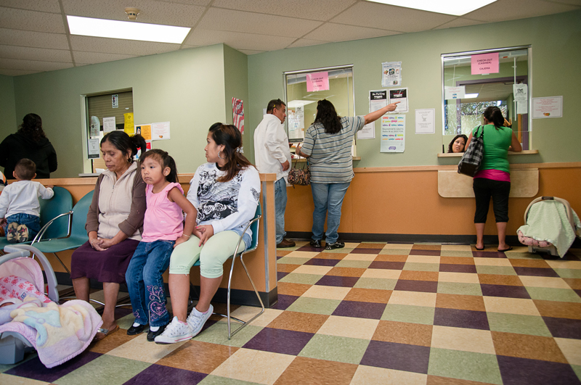
Qualitative vs. Quantitative
Qualitative Data:
Clean and tidy
Bright lights
Quantitative Data:
Number of staff
Proportion of patients that are elders
Notes:
Data collection can take place anywhere. We can use this picture of patients at a community clinic to demonstrate how information can be gathered; and how to distinguish between the two common types of data, best described as either qualitative or quantitative
Qualitative methods measure quality and collect descriptive information. Data tend to be subjective, and findings for program evaluation are usually reported as themes or vignettes. Some examples of qualitative measures can be descriptions about the waiting room that can be seen, heard, or otherwise observed.
Quantitative methods measure quantity and collect data that can be counted or expressed numerically. Quantitative data is usually reported in the form of rates, proportions, and percentages. Some examples of quantitative measures could include the number of staff present, proportion of youth or elders, or the number of chairs in the room.
Both qualitative and quantitative methods provide information that can be used to learn more about people’s knowledge, perceptions, attitudes, and beliefs. Both methods can also be used to assess the process and outcomes of programs, interventions or services.
Now we are going to review some of the most common qualitative and quantitative collection methods.

Slide 8
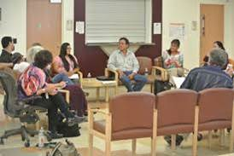
Qualitative Methods
Interviews
Focus Groups
Creative Expression & Storytelling
Participant Observation
Notes:
Let’s start with by looking at some qualitative methods.
Interviews are individual, in-depth conversations that can be used to understand how a specific intervention or participation in a program has impacted an individual for outcome evaluations, and can also be used for process evaluations to understand how a participant experienced an intervention.
Similar to interviews, focus groups are small group discussions facilitated by a moderator that allow you to gather in-depth information from multiple people at once. Focus group discussions allow you to collect descriptive data about a specific topic. The purpose of conducting a focus group is not to reach consensus among participants, but rather to stimulate conversation and gain insight about people’s experiences and perceptions.
Another qualitative data collection method is Creative Expression & Storytelling a rich, exploratory process that allows you to observe and analyze the influence your program has on participants. This approach to data collection recognizes that credible evidence goes beyond ‘just words’. Some examples of creative expression include photovoice, digital storytelling, and creative arts for healing, such as traditional Native art activities.
Finally, participant observation involves gathering information about a program as the program’s activities occur. The goal of participant observation is to assess fidelity to implementation plans or observe skills and behaviors learned in an intervention.

Slide 9
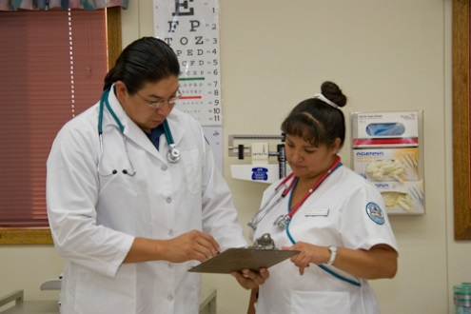
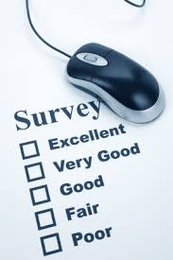
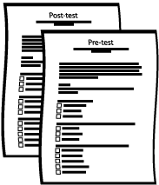
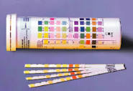
Quantitative Methods
Observation Checklists
Document Review
Surveys
Tests
Biomedical Markers
Notes:
Now let’s look at common quantitative methods.
Like a shopping list, observation checklists help you know what you are looking for and check them off. Observation checklists can help evaluate what actually takes place during programming or service processes, in order to assess if services or activities are being carried out as planned. The purpose of observation checklists is to count how many times a specific measurable action takes place during program or service delivery, daily workflow task, or be used to assess a skill or behavior. This method of data collection can inform why or why not an outcome objective is being reached, and is particularly well-suited to process (or implementation) evaluations.
Another method is Document Review, which is the process of collecting and reviewing existing documents to analyze information about the organization’s activities and population served. Document review can help track changes for identified indicators in existing records, such as changes in health status; but can also track other information like the number of visits. Document review can also include content analysis of emails or meeting minutes to identify whether activities and processes related to program implementation were accomplished.
Surveys use standardized tools to measure an individual’s characteristics, behaviors, knowledge, perceptions, attitudes, or beliefs. Surveys allow you to gather descriptive data from a large group of people relatively quickly. Surveys can either be done on paper, online, administered by in interviewer either in-person or other the phone.
A modification of the standard survey are Pre and post tests are, that offer a simple way to measure changes in knowledge. This assessment approach works by comparing what an individual knew before participation through a pre-test and answers to the same test after the interventions. Pre and post test can be matched to a curriculum model, and are ideal to evaluate a change in knowledge or improvement in skill performance over a period of time. Pre- and post tests can link changes more directly to the program or intervention than a single test that captures information from one point in time.
Lastly, there are Biomedical Markers, also known as biomarkers, are distinct biochemical, genetic, or molecular characteristic or substance that is an indicator of a biological condition or process. Biomarkers include blood, saliva, body tissue, or urine. Two common examples of using biomarkers in program evaluation are A1c tests that measure blood glucose levels to asses diabetes interventions, or urine tests that can detect abstinence from substance abuse.

Slide 10
Mixed Method Approach
Qualitative Method
Quantitative Method
Credible Data Gathered
Focus Groups
Interviews
Document Review
Surveys
Notes:
Today we have introduced a variety of qualitative and quantitative methods for data collection. While one data collection method conducted very well can produce credible data, here we are going to discuss the benefits of using a mixed-method approach to data collection.
Generally, a mixed method approach uses two or more data collection methods in an effort to increase understanding of processes and outcomes by integrating different ways of knowing. Using a combination of data collection methods improves evaluation by balancing the limitations of one type of data by the strengths of another.
A mixed method approach can include two or more qualitative or quantitative methods.
For example, if we want to learn we want about barriers that limit clients from accessing substance abuse treatment services, we could hold focus groups with staff and conduct interviews with clients. Together the two qualitative methods gather valuable information from different viewpoints that can help identify possible solutions to overcome client barriers to accessing substance abuse treatment.
Likewise, if we want to assess if implementation plans to improve client access to substance abuse treatment services are being followed as planned, we could use a combination of quantitative methods such as document review and surveys. Together these two quantitative methods can help staff identify if the changes they have implemented have been effective in decreasing the barriers clients face when attempting to access substance abuse treatment.

Slide 11
Mixed Method Approach: Triangulation
Quantitative Data & Results
Interpretation
Qualitative Data & Results
Notes:
Another purpose of combining data collection methods is to confirm or reject initial or unexpected findings from qualitative or quantitative work, this is known as triangulation. With Triangulation, both qualitative and quantitative data collection methods are used simultaneously, with the methods building credibility in your evaluation findings because you are able to provide explanation for your findings. Qualitative data provides “depth” that complements more general findings found in quantitative data; furthermore, mixed methodology allows for a diversity of viewpoints to be presented; reflecting relationships and meaning related to processes and outcomes.
There are multiple combinations of data collection methods you can decide to use, just be sure to plan in advance how you integrate the two methods, or have a plan for how each selected method will build upon the previous one and improve your evaluation efforts.

Slide 12
Selecting the Best Method
Evaluation Question
Indicators
Data Collection Method
How we collect the information to answer our question
What we examine
What we ask
Notes:
The various data collection methods and mixed-method evaluation approaches provide numerous ways to gather the information that you need to answer your specific evaluation questions. Keep in mind that the questions we choose to ask drives the indicators we examine, how we collect data, and ultimately the information we receive, which in turn drives our actions.
Once you have determined your evaluation questions, then you will have to consider the appropriate indicators that you can measure to gather the information necessary to answer your question. In program evaluation, indicators are tangible things we can see, hear, or read that demonstrate the outcome.
Process indicators monitor how well the program is implemented, if it is reaching the intended target population and if it is of an acceptable quality. Process indicators may include things like client satisfaction or number of participants in a class. Outcome indicators are used to assess if the program outcomes or goals have been achieved and are therefore more likely to include actual behaviors, health status and quality of life.
The data collection method that we select should be best approach that will lead us to gather the information we need to answer our evaluation questions. We should keep in mind the most efficient way to collect the data we need, considering the amount of time needed , cost, and available resources.
Next, we have provided a few scenarios to help you practice weighing the considerations for selecting an appropriate data collection method based on given a evaluation question and indicators.

Slide 13
Practice & Review
Evaluation Question
How effective were outreach efforts in engaging youth in GONA?
Indicators
Attendance
Where participants heard about the event
Types of outreach conducted
Number of flyers posted, listserv postings
Process Objective: Recruit 150 youth to participate in GONA.
Notes:
Let’s say we are conducting a process (or implementation) evaluation of our Gathering of Native Americans (GONA) activities because we want to assess what outreach activities had the greatest reach for our community-based substance abuse prevention activities to report to our Board of Directors.
Staff could have brainstormed this list of indicators they feel are good signs of effectiveness of their Gathering of Native Americans outreach efforts. Think about the data collection methods we introduced earlier in today’s session, which approach do you think is most effective and efficient in answering this evaluation question?

Slide 14
Practice & Review
Attendance logs
Summary reports
Outreach materials
Social media activity
Notes:
In this scenario, Document Review would be appropriate because evaluators could refer to items such as attendance logs, summary reports of outreach activities, materials used for outreach, and even website or social media activity to evaluate the effectiveness of outreach activities to recruit youth to participate in GONA activities to prevent substance abuse.
Document review requires clearly defining the data that you are seeking, looking through the records that store that information, and then quantifying the number of times a specific measurable action occurs. For example, staff could analyze how many youth sign up to join their list serve when completing community-based outreach activities at different locations.
While there are multiple approaches to gather the data that you need to collect, you want to opt for the method that will best answer your questions, has the least burden on clients and staff, and which you have the resources to gather and analyze.
Let’s try one more exercise for weighing the considerations for selecting a data collection method together.

Slide 15
Practice & Review
Indicators
Identified coping skills for managing stress
Outcome Objective: 30 days after discharge, clients released from residential substance abuse treatment will report implementing stress management skills not involving alcohol or substance abuse.
Perceived strengths and weaknesses of programs offered post-treatment
Evaluation Question
How are clients managing stress post discharge?
Notes:
Let’s say we are evaluating short-term outcomes of clients maintaining sobriety after discharge from inpatient substance abuse treatment because we want to identify challenges to maintaining sobriety following treatment in order to improve aftercare support.
Based on the list of indicators presented, which data collection method covered in today’s session is the most effective and efficient approach to gather information about clients to answer our evaluation question?

Slide 16
Practice & Review
Multiple perspectives
Direct feedback
Notes:
Conducting a focus group with current program participants in aftercare services is a good method to answer this type of evaluation question. The focus group moderator could ask participants about the challenges they face while striving to maintain their sobriety, particularly how they are managing their stress while abstaining from alcohol and substance abuse.
Focus groups provide a relatively cheap, quick way to gather qualitative data from multiple people. In this scenario, a focus group would offer in-depth information about the coping skills they perceive to be the most helpful in maintaining sobriety, and how they have managed their self-care throughout the process. During the focus group, the moderator would be able to ask questions and use probes to stimulate conversation about each person’s unique stressors and how they are coping with those challenges. Collectively their feedback can help program supervisors and administrators to integrate coping skills perceived to be the most helpful into their aftercare services and programming.

Slide 17
Summary
Respect for clients & community
Choose the method that best fits your evaluation question, the source of information, and resources (financial, expertise, time, etc.).
Notes:
Today we briefly introduced a lot of information on the principles of data collection and things to consider when choosing a data collection method as well as qualitative and quantitative methods.
The most important principle to remember when collecting data is respect; this includes respecting the people or places from which you are colleting the data by clearing communicating the purpose and uses of the evaluation and what will happen to their data. Respect also includes respect for the larger community by ensuring that your program evaluation is culturally responsive, keeping the needs, strengths, priorities and interests of the community.
Be sure to choose the best method that fits your evaluation question. Remember that both qualitative and quantitative methods can provide valuable information when conducted well. Also, consider using a mixed-method approach, which offers the benefit of enhancing the strengths and balancing out the weaknesses of each approach, and will increase the validity and add depth to your findings. The information need to answer your questions, where or who has the information, your available resources, and how much time you have should drive your method selection.
I’d like to thank each of you for joining. At the end of this slide deck are a list of resources to support evaluation efforts. I am going to open up the line for questions, comments, and discussion.

Slide 18
Questions
Contact Julie Loughran at juliel@uihi.org or 206.812.3042 to receive individualized consultation on program evaluation.
26
Notes:
At conclusion of questions: UIHI Staff are offering individual consultation on program evaluation for staff at Urban Indian Health Organizations. Please contact Julie Loughran to find out more about this free service. She can be reached at 206-812-3042 or juliel@uihi.org.
Once again thank you for joining We would love to have you join us again next Tuesday, August 26 at 12pm PST for the next installment that will cover analyzing and sharing data collection.

Slide 19
Data Collection Resources
American Indian Higher Education Consortium
http://indigeval.aihec.org/Pages/Documents.aspx
Creative Narrations
http://www.creativenarrations.net/who
National Science Foundation
http://www.nsf.gov/pubs/2002/nsf02057/nsf02057_4.pdf
Northwest Center for Public Health Practice
https://www.nwcphp.org/training
University of Wisconsin-Extension
http://learningstore.uwex.edu/assets/pdfs/g3658-4.pdf
Notes:
Here are some links to resources that provide detailed guides for choosing a data collection method, templates for standardized data tools, and frameworks to support a culturally-responsive evaluation.
Keeping in line with today’s session on gathering credible data, we would appreciate it if you could please take a few minutes to complete the survey that will appear on your screen to help us improve future webinars. Thank you so much for joining us today!

Slide 20
Urban Indian Health Institute Seattle Indian Health Board 606-12th Avenue South Seattle, WA 98114 Phone: (206) 812-3030 Fax: (206) 812-3044 Email: info@uihi.org Website: www.uihi.org

