Slide 1
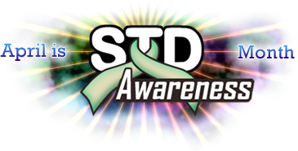
Epidemiology of STD, HIV and Hepatitis C among AI/AN Populations
Melanie Taylor MD, MPH
Centers for Disease Control and Prevention
National STD Program, Indian Health Service
June 2011

Slide 2
Overview
Surveillance overview
HIV
STD
Viral Hepatitis
New STD/HIV Provider Tools
National guidance and recommendations
Sample Policies/Protocols
Partner management including EPT
Resources

Slide 3
Data Limitations
Limited data on urban AI/AN populations
Racial Misclassification
Data frequently underestimate AI/AN rates
Misclassification identified through evaluation of birth record data among HIV and STD cases
Rates were 30-50% higher than recorded among AI/AN
Intended Use of Data
Data Resources
Data Interpretation

Slide 4
Survival After an AIDS Diagnosis

Slide 5
Chlamydia by Race, 2009 CDC, STD Surveillance, 2009

Slide 6
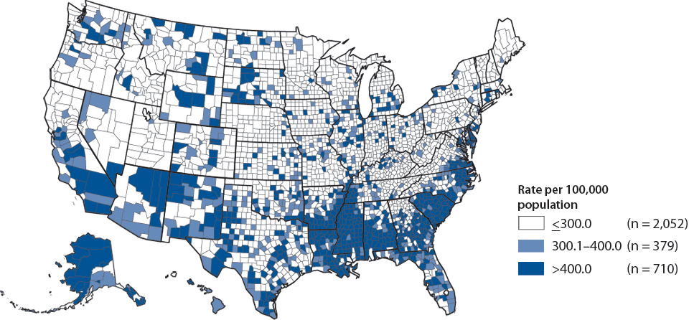
Chlamydia Rates by County, 2009 CDC, STD Surveillance, 2009
Source: Centers for Disease Control and Prevention, Sexually Transmitted Disease Surveillance, 2008. Atlanta, GA: U.S. Department of Health and Human

Slide 7
Chlamydia Rates by IHS Area, 2009*
Percent change 2008-2009
IHS Area | % Change
Aberdeen | + 5.2
Alaska | + 5.0
Albuquerque | + 5.2
Bemidji | - 2.2
Billings | - 4.4
California | - 16.1
Nashville | + 12.3
Navajo | - 4.7
Oklahoma City | - 3.7
Phoenix | - 6.5
Portland | - 3.3
Tucson | + 5.2
Total IHS Areas | - 0.3
*Source: IHS STD Surveillance Report, 2009 – Preliminary data

Slide 8
Chlamydia by Gender, Age, 2009 CDC, STD Surveillance, 2009

Slide 9
Gonorrhea Rates by IHS Area, 2009*
Percent change 2008-2009
IHS Area | % Change
Aberdeen | + 4.2
Alaska | + 88.9
Albuquerque | - 8.0
Bemidji | + 10.5
Billings | - 20.0
California | - 128.6
Nashville | -11.1
Navajo | +1.0
Oklahoma City | + 8.8
Phoenix | - 26.9
Portland | - 69.1
Tucson | - 15.4
Total IHS Areas | + 10.7
*Source: IHS STD Surveillance Report, 2009 – Preliminary data

Slide 10
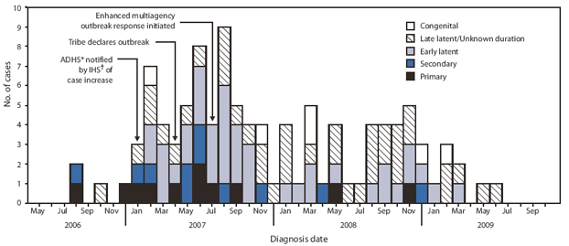
Syphilis Outbreak Among American Indians - Arizona, 2007-2009 Morbidity and Mortality Weekly Report (MMWR) February 19, 2010 / 59(06);158-161

Slide 11
Major IHS HIV Initiatives
National Expanded HIV Testing Initiative (I/T/U)
Effective Behavioral Interventions (NARCH)
Data Collection/ Quality Improvement
Universal HIV Screening
HIV screening following STD diagnosis
Prenatal HIV Screening
Site Specific Pilot projects (GIMC, PIMC, Pine Ridge) related to provision of care and prevention
New Media projects
Collaborations with multiple partners (Fed, Tribal)
~ 30+ activities ongoing
Notes:
Spreadsheet joke 119 line items.

Slide 12
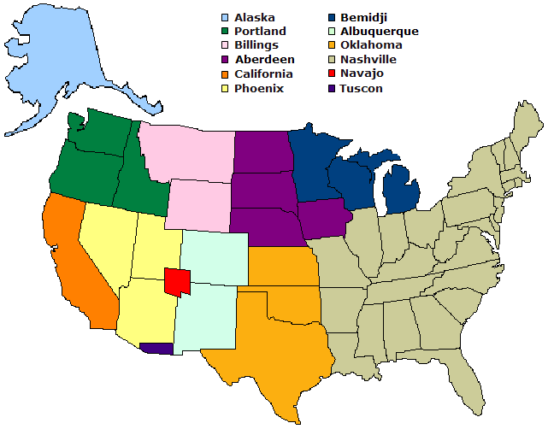
HIV/AIDS Program Sites
IHS Areas
Indian Family
Health Clinic
Alaska
SD Urban
Indian Health
Oglala
Sioux
Tribe
Tucson
Alaska
Native
Tribal Health
Consortium
Turtle
Mountain
White
Earth, MN
Ft. Peck
Pine Ridge
Rosebud
Winnebago
Colville
Portland
Billings
American Indian
Health Services
of Chicago
NARA of
the Northwest
Bemidji
Sacramento
Native American
Health Center
Aberdeen
Native American
Health Center
Phoenix
California
Albuquerque
United
American Indian
Involvement
Nashville
Nebraska
Urban Indian
Health Coalition
San Diego
American Indian
Health Center
Navajo
Oklahoma
Phoenix
Indian
Hospital
Tucson
Hunter
Health
Clinic
Shiprock
(Northern
Navajo
Medical
Center)
Gallup
Indian
Medical
Center
Albuquerque
Indian
Hospital
Haskell
Crownpoint
Mescalero
Service Unit
Claremore
White
River
Denver Indian
Health & Family
Services
Lawton
Native American
Community Health
Center
Native Americans
for Community
Action
Ft.
Defiance
Urban
Inter-Tribal
Center of TX
Pawnee
IHS
Tribal
Urban
First Nations
Community
Healthsource

Slide 13
Hepatitis C

Slide 14
Hepatitis C
Prevalence, U.S.
Overall prevalence of anti-HCV from NHANES (1999-2002)
3.8 million (1.6%)
Overall prevalence of chronic infection derived from NHANES III (1988-1994)
2.7 million (1.3%)
Correcting for patient groups under-represented in NHANES (incarcerated, homeless, hospitalized, active duty military, and nursing home residents)
5 million (~2.4%)
¹Armstrong et al. AASLD 2004; poster 31. Edlin, AASLD 2005
²Alter et al. N Engl J Med. 1999;341(8):556-562.

Slide 15
Notes:
Prevalence of HCV in Select Populations
Key Point: The prevalence of individual populations in the United States is presented above.
References
1. Centers for Disease Control. Prevention and control of infections with hepatitis viruses in correctional settings: recommendations and reports. Morb Mortal Wkly Rep. 2003;52(RR-1):1-33.
2. Edlin B. Prevention and treatment of hepatitis C in injection drug users. Hepatology. 2002;36(5 suppl 1):S210-S219.
3. National Household Survey on Drug Abuse. The NHSDA report: injection drug use. March 14, 2003.
4. Poles M et al. Hepatitis C virus/human immunodeficiency virus coinfection: clinical management issues. Clin Infect Dis. 2000;31:154-161.
5. Labreque S. In: Hepatitis C Choices. 2002.
6. Alter M et al. The prevalence of hepatitis C virus infection in the United States, 1988 through 1994. N Engl J Med. 1999;341:556-562.
7. Nyamathi A et al. Risk factors for hepatitis C virus infection among homeless adults. J Gen Intern Med. 2002;17(2):134-143.
8. Bräu N et al. Prevalence of hepatitis C and coinfection with HIV among United States veterans in the New York City metropolitan area. Am J Gastroenterol. 2002;97:2071-2078.
9. Jonas M. Children with hepatitis C. Hepatology. 2002;36(5 suppl 1):S173-S178.

Slide 16
Prevalence of Anti-HCV, United States, 1999-2002 (NHANES)
Overall prevalence: 1.6% (4.1 million)
Armstrong, et al, Ann Intern Med. 2006;144:705-714.

Slide 17
Notes:
Slide 1c - Incidence of Acute, Symptomatic Hepatitis C/Non-A, Non-B Hepatitis* — United States, 1992–2008
No hepatitis C vaccine exists. In 2008, a total of 878 acute, symptomatic cases of hepatitis C hepatitis were reported nationwide. The overall incidence rate for hepatitis C hepatitis virus remained stable at 0.3 cases per 100,000 population

Slide 18
Notes:
Slide 3c - Incidence of Acute, Symptomatic Hepatitis C/Non-A, Non-B Hepatitis* by Sex — United States, 1992–2008
Historically, rates of acute, symptomatic hepatitis C hepatitis have been higher among males than females. Since 2002, the male-to-female ratio of rates has declined and was nearly 1 in 2008. In 2008, incidence among males and females was 0.3 cases per 100,000 population.

Slide 19
Notes:
Slide 4c - Hepatitis C/Non-A, Non-B Hepatitis* by Race/Ethnicity — United States, 1992–2008
In 2008, acute, symptomatic hepatitis C hepatitis rates were highest among American Indian/Alaskan Natives (0.5 cases per 100,000 population) and lowest among Asian/Pacific Islanders (0.04 cases per 100,000 population).

Slide 20
HCV in AI/AN Populations
In 2009, American Indian/Alaska Natives were almost twice as likely to be diagnosed with Hepatitis C, as compared to the White population.
In 2008, American Indian/Alaska Natives ages 40 years and over, were 2.5 times more likely to have Hepatitis B, than non-Hispanic Whites.
Death rates from viral hepatitis are 2x greater than for non-Hispanic whites
Limited data on chronic HCV
DHHS, Office of Minority Health http://raceandhealth.hhs.gov/templates/content.aspx?lvl=3&lvlid=541&ID=6494

Slide 21
HCV Prevalence in Urban AI Clinic
243 AI patients representing 30 different tribes presenting to an urban clinic were screened for HCV antibodies
Omaha, Nebraska
Anti-HCV antibodies found in 11.5%
Risk factors
IVDU
Cocaine use
Tattoos
Having a sexual Partner with HCV
Neumeister et al. JOURNAL OF THE NATIONAL MEDICAL ASSOCIATION VOL. 99, NO. 4, APRIL 2007 . http://www.nmanet.org/images/uploads/Publications/OC389.pdf

Slide 22
Rural AI and HCV
Ft Peck Reservation, Blackfeet Tribe, Montana
2009
Population 11,000,
500 cases (4.5% positivity)
Risk
IVDU
Intervention
Needle exchange program
http://missoulian.com/news/local/article_52e17ec6-b622-11de-be68-001cc4c002e0.html

Slide 23
Risk Factors for Remote and Recent HCV Infection
Remote (>~20 yrs ago)
Recent (<~20 yrs ago)
Injection Drug Use
Injection Drug Use
Transfusion
Unknown
Sexual
Transfusion
Other*
Sexual
Unknown
Other*
*Nosocomial, occupational, perinatal

Slide 24
HCV Screening
75% of people chronically infected with HCV are unaware of their diagnosis
Blood borne and sexual transmission
High burden of morbidity and mortality associated with chronic HCV infection
Higher rates among AI/AN populations
Effective treatment is available
Treatment more effective the shorter the duration of infection

Slide 25
New IHS/CDC Policy
Purpose: To expand opportunities for confidential STD/HIV screening and treatment among AI/AN populations
Rationale:
Compliance with national standards and IHS performance measures
High STD rates among AI/AN populations
Differences in time to treatment
Limited partner treatment in some areas
Late HIV diagnoses
Provider turnover within IHS

Slide 26
IHS/CDC Protocol
Clear step by step clinical guidance:
STD/HIV screening in pregnancy
HIV screening in general populations
STD screening in women and special populations
STD treatment
Partner management
Presumptive treatment of partners
Patient delivered partner therapy (PDPT)
Vaccination (HPV, HBV)

Slide 27
IHS/CDC Guidance
Supplements:
IHS STD/HIV screening recommendations (chart)
Performing a sexual risk assessment
Patient delivered partner therapy
Patient information sheet (chlamydia & gonorrhea)
Partner information sheet (chlamydia)
Partner information sheet (gonorrhea)

Slide 28
Expedited Partner Therapy (EPT)

Slide 29
IHS/CDC Protocols
Timeline
Development 2010-2011
TON Model following syphilis outbreak
Material for inclusion
Medical review
CDC Clearance May 2011
IHS OGC Review, Approval and Clearance May 2011
HHS, IHS, CDC branding May 2011
Printing, Web Placement, Distribution, June 2011

Slide 30
IHS/CDC Protocols
Intended for use and/or adaptation by:
IHS Service Units
Remote or village-level clinics
Regional IHS medical centers
Tribal corporation medical facilities
638 facilities
Urban Indian health centers

Slide 31
Draft Tools
Sample Policy
Sample Protocol

Slide 32
Patient Management
Client Information
Partner Information

Slide 33
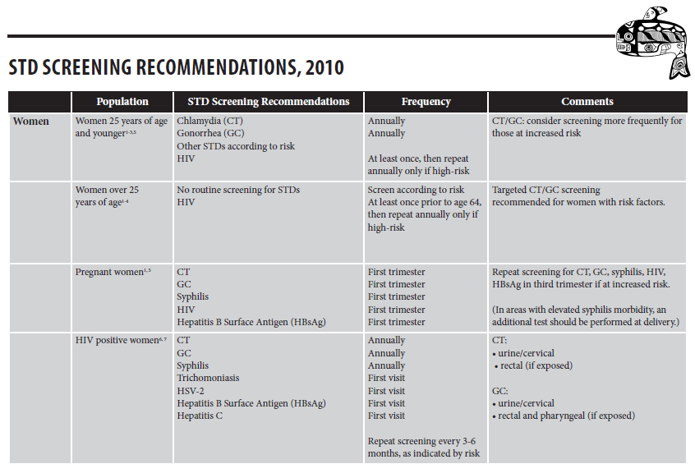
National Screening Guidance

Slide 34
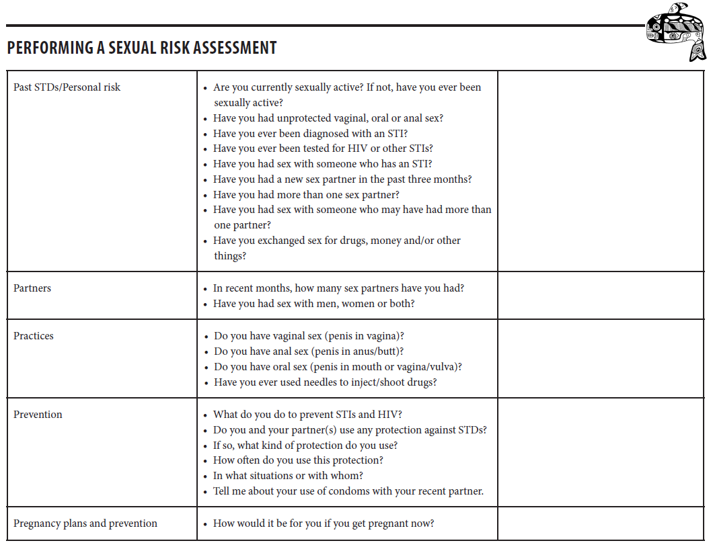
Risk Assessment Tools

Slide 35
Community Partners
Valuable resource
Help build organizational capacity
Complimenting/enhancing data
Potential partners
State/local Health Departments
County Health/STD Departments
State/Regional Infertility Prevention Programs (IPP)
I/T/U partners – Project Red Talon
Tribal Epidemiology Centers
Centers for Disease Control and Prevention
IHS National STD/HIV Programs

Slide 36
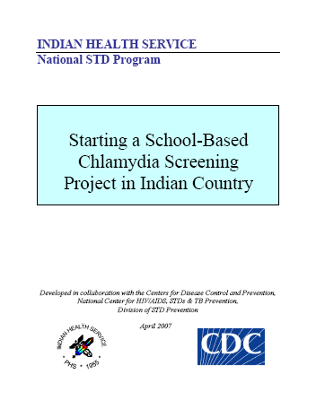
Resources
IHS STD Surveillance Report
Area-level profiles
Chlamydia Screening Guidelines
Screening in Schools
Screening in Tribal Jails
STD/HIV Peer Educator Curriculum adapted for Native youth
Project Red Talon
Tribal Advocacy Kit
Educational materials
Technical Assistance

Slide 37
Melanie Taylor, MD, MPH CDR, US Public Health Service Medical Epidemiologist Centers for Disease Control and Prevention Phone 602-372-2544 mdt7@cdc.gov
Thank you

